Slide 1
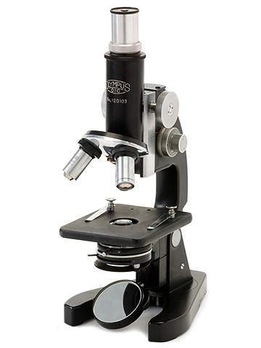
BIOLOGY

Slide 2
COURSE STRUCTURE
Unit | Title | Marks
1. | Diversity of Living Organisms | 7
2. | Structural Organisation in Plants & Animals | 11
3. | Cell: Structure and Function | 15
4. | Plant Physiology | 17
5. | Human Physiology (A) - Section for OTBA Human Physiology (B) *This section will be assessed through OTBA only in SA2 only | *10+10
 | Total | 70

Slide 3
Linkage with IX & X syllabus
Basic concepts learnt in class IX and X are applied or advanced in XI and XII syllabus such as
Cell Biology
Animal Physiology
Plant Physiology
Genetics and Evolution
Ecology
Diversity of Organisms

Slide 4
Assessment Pattern
Theory -70 marks
Practicals – 30 marks
Total – 100 marks

Slide 5
Theory Assessment Pattern
Theory paper has five sections
Section A 1 mark 5 questions →1 x5= 5
Section B 2 marks 5 questions → 2x5= 10
Section C 3 marks 12 questions → 3x12= 36
4 marks 1 value based question → 1X4=4
Section D 5 marks 3 questions → 5x3=15
Questions are of different typology such as knowledge, comprehension, skill, application, Value Based, analysis.

Slide 6
PRACTICALS ASSESSMENT
Total Marks for Practicals ->30 Marks
a) Experiment based on practical syllabus
b) Journal
c)Investigatory project
The topic selected for Investigatory project should be linked with the syllabus of class XI Biology.

Slide 7
Text Books and Reference Books
NCERT Text book of Biology – class XI
Pradeep’s Text Book of Biology - class XI
Cell and Molecular Biology by De Robertis and Robertis
Biochemistry by Satyanarayana
Plant Physiology by Devlin
Biology by Raven and Johnson
Biology by Pearson

Slide 8
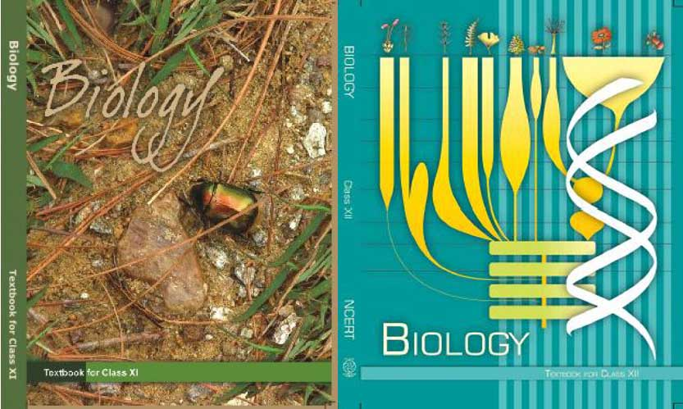

Slide 9
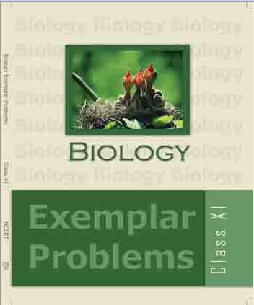

Slide 10
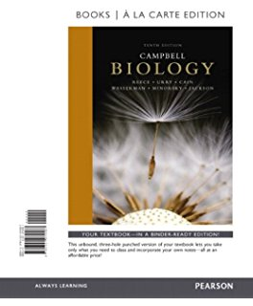

Slide 11
Treasure of our School
Magazines
Biology Today
Junior Science Refresher
BBC Knowledge
Science reporter
Terra Green
All Reference books mentioned in previous slide

Slide 12
Reference Web sites
ncerthelp.com
www.topperlearning.com
www.cbse.edurite.com
Mycbseguide.com
www.learncbse.in
www.jagranjosh.com
www.coursera.com

Slide 13
Competencies and skills developed
Laboratory skills such as handling of lab apparatus, slide preparation and Identification,Observation skill, Skill of Scientific drawing, Analytical skill, Problem solving skill etc.
Competencies such as the ability to synthesize, evaluate and analyze real life situation.
Develop curiosity to further explore on the topic.
Application of the concept learnt in development of new technology

Slide 14
THANKYOU

